Slide 1

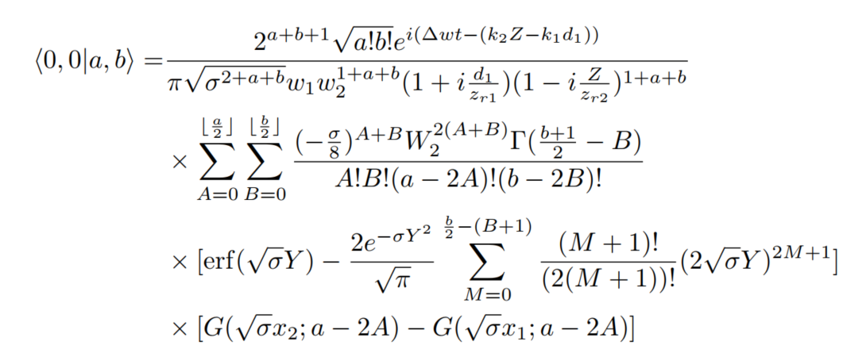
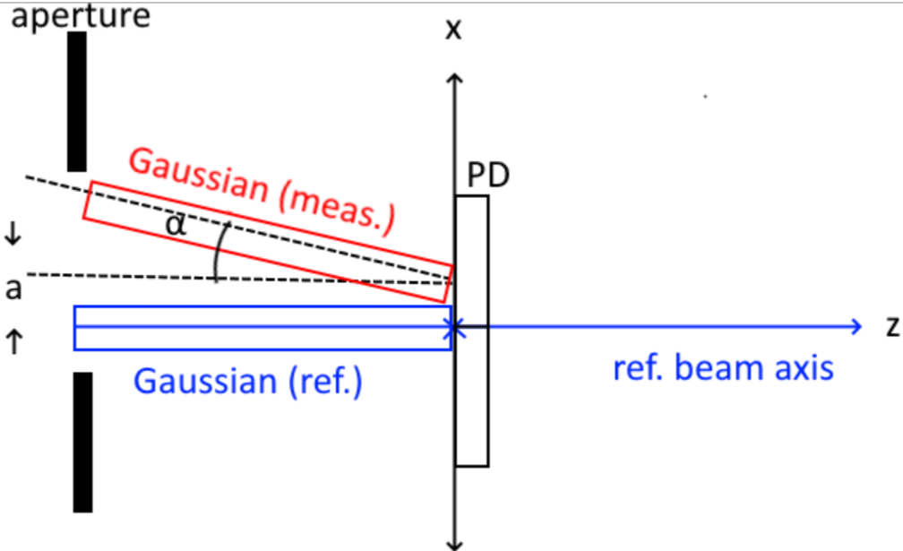
First-order Tophat-Gaussian Signals
1st order series approximation in shift and in tilt
Apply scattering to modes before getting signals (scattering not timed)
Time
Average execution time (1 LPS & DWS datapoint): ~0.84 s
~42 s / 51 points (DWS and LPS)
~O([max tophat mode]³): 100 POINT execution times
Rotation about center of PD
1mm radius tophat
Tophat Mode (mode order/2) | Total Time (100 points) [s]
34 | 94.01
28 | 50.34
18 | 11.93

Slide 2
Parameters (center of rot. PD)
Param. | Default Value [mm] | Nomenclature
PD-ref. beam distance , PD-meas. beam distance | 10 | Z = z_PD - z_m , d_1 = z_PD – z_LO
PD size | 2x2 | x_R2,x_L1
PD gap | 0.02 (20 [micron] right & left) | x_R1,x_L2
Meas. Beam w₀ | 0.23067 (1mm-radius tophat) | w_1
Meas. Beam z₀ | 0 (at aperture) | z_m
Ref. Beam w₀ (w_2) | 1 | w_2
Ref. Beam z₀ | 0 (at aperture) | z_LO
Shift | 0 | a
Tilt | {-500,500} [microrad] | alpha_arr

Slide 3
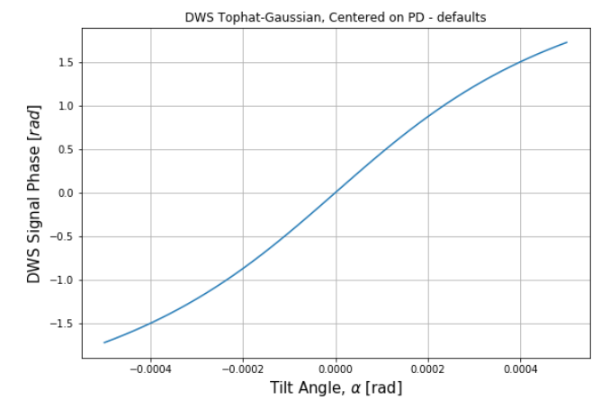
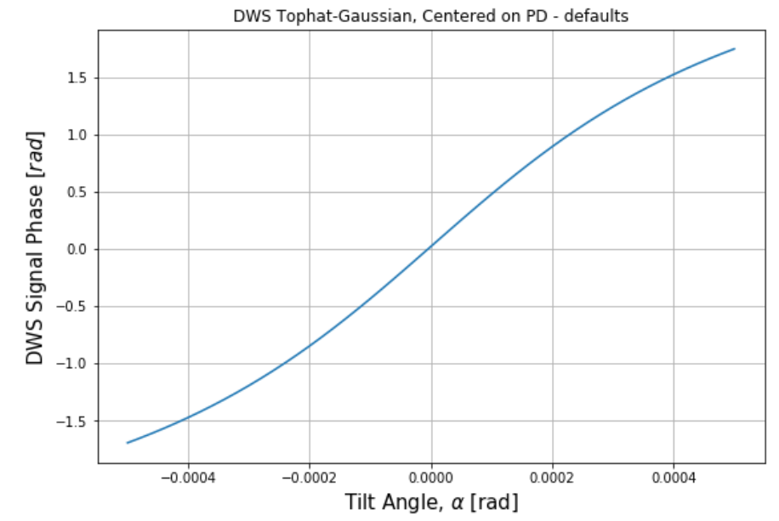
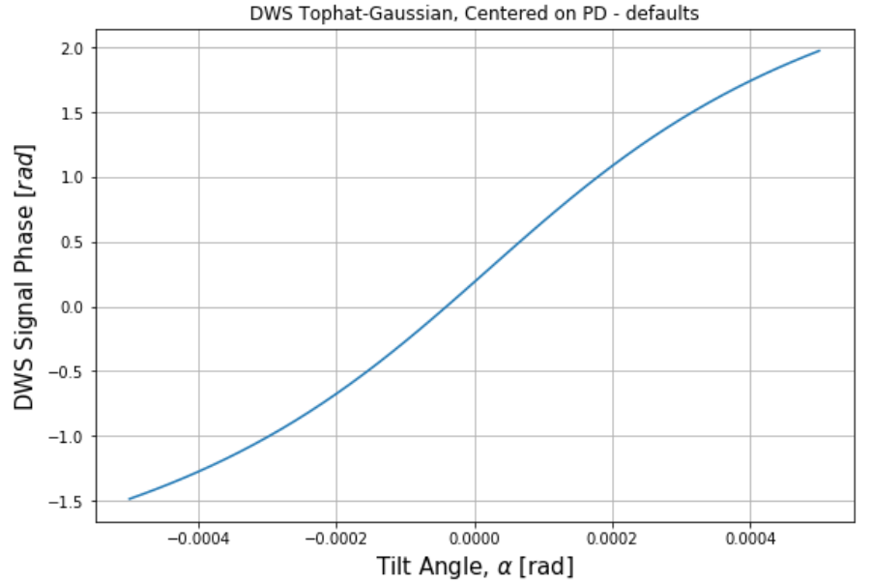
Defaults DWS
10 micron
0
100 micron
Param. | Default Value [mm]
PD-ref. , meas. beam distance | 10
PD size | 2x2
PD gap | 0.02 (20 micron right & left)
Meas. Beam waist | 0.23067
Ref. Beam waist | 1
Shift | 0
Tilt | [-500,500] microrad

Slide 4
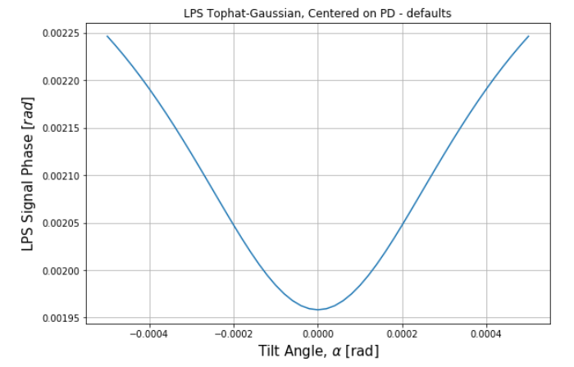
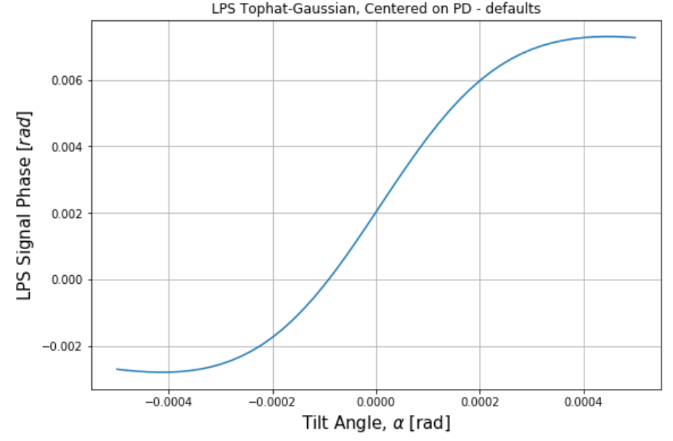
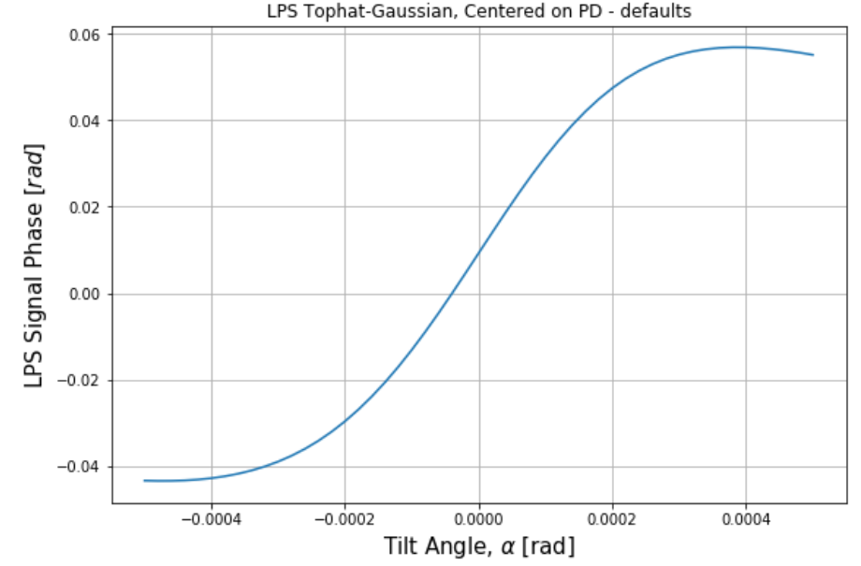
Defaults LPS
0
10 micron
100 micron
Param. | Default Value [mm]
PD-ref. , meas. beam distance | 10
PD size | 2x2
PD gap | 0.02 (20 micron right & left)
Meas. Beam waist | 0.23067
Ref. Beam waist | 1
Shift | 0
Tilt | [-500,500] microrad

Slide 5
Shift = 0
Default values
Changing one parameter/slide

Slide 6
Defaults
Param. | Default Value [mm]
PD-ref. , meas. beam distance | 10
PD size | 2x2
PD gap | 0.02 (20micron right & left)
Meas. Beam waist | 0.23067
Ref. Beam waist | 1
Shift | 0
Tilt | [-500,500] microrad

Slide 7
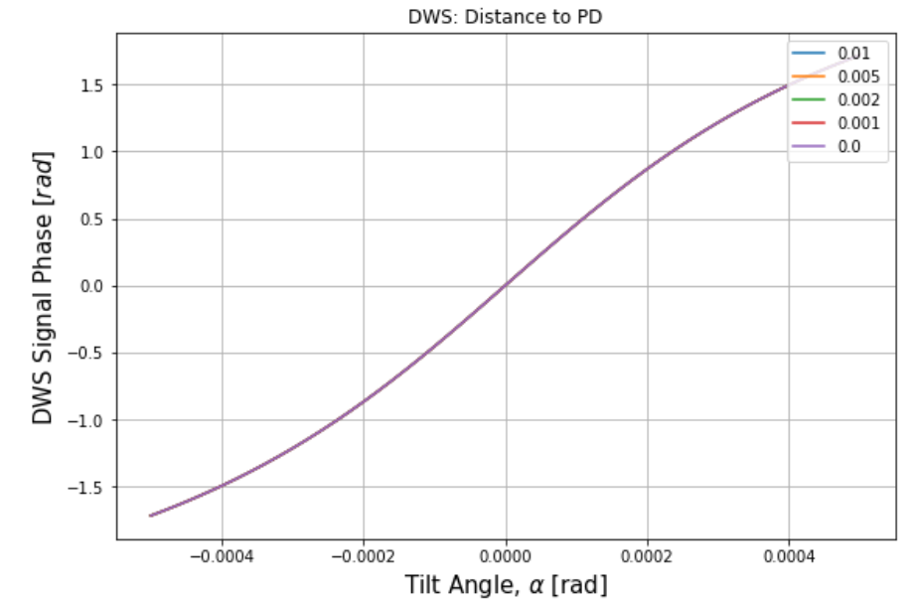
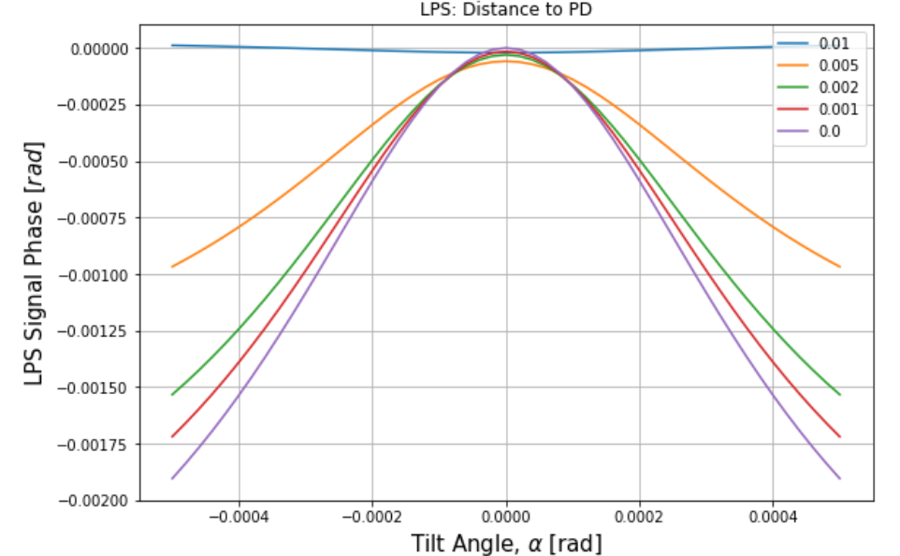
Distance to PD[mm]
Param. | Default Value [mm]
PD-ref. , meas. beam distance | 10
PD size | 2x2
PD gap | 0.02 (20micron right & left)
Meas. Beam waist | 0.23067
Ref. Beam waist | 1
Shift | 0
Tilt | [-500,500] microrad
[m]
[m]

Slide 8
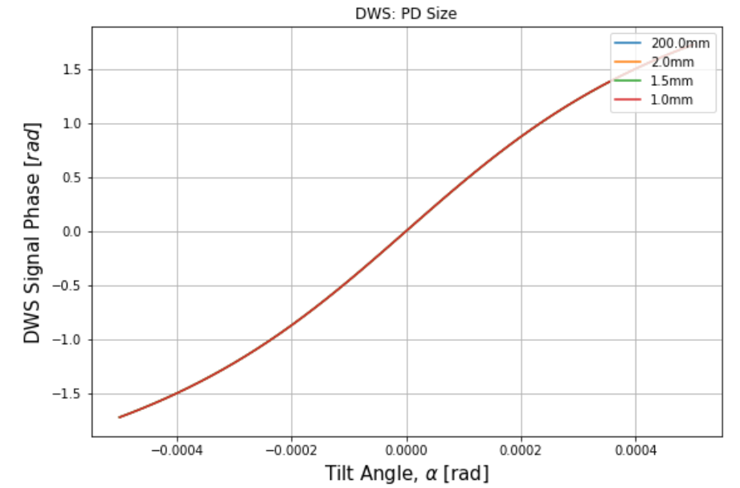
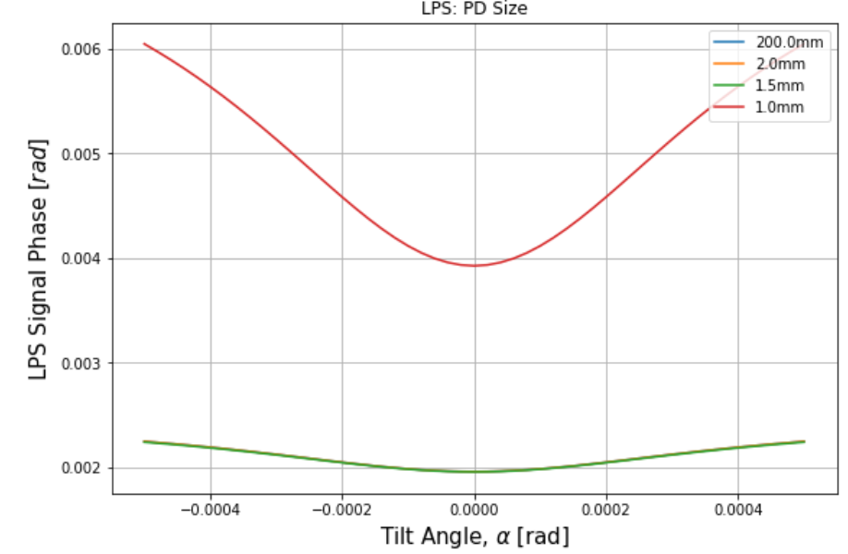
PD size [mm]
Param. | Default Value [mm]
PD-ref. , meas. beam distance | 10
PD size | 2x2
PD gap | 0.02 (20micron right & left)
Meas. Beam waist | 0.23067
Ref. Beam waist | 1
Shift | 0
Tilt | [-500,500] microrad

Slide 9
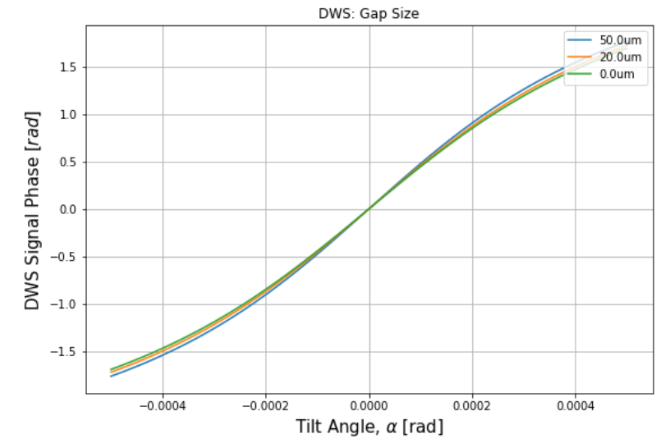
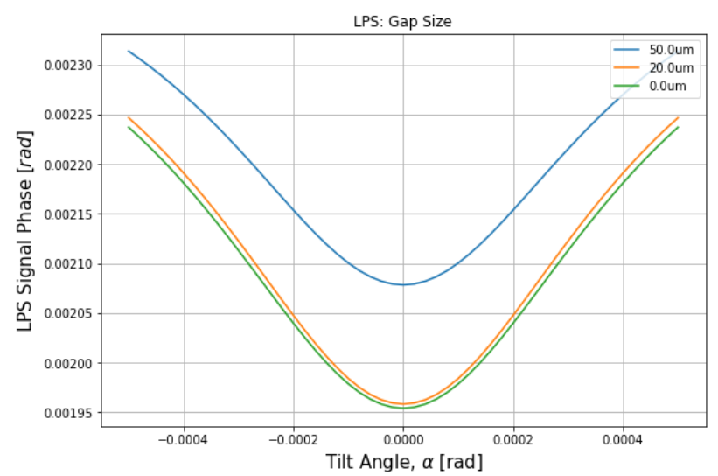
Gap Size [mm] (half-gap)
Param. | Default Value [mm]
PD-ref. , meas. beam distance | 10
PD size | 2x2
PD gap | 0.02 (20micron right & left)
Meas. Beam waist | 0.23067
Ref. Beam waist | 1
Shift | 10 micron
Tilt | [-500,500] microrad

Slide 10
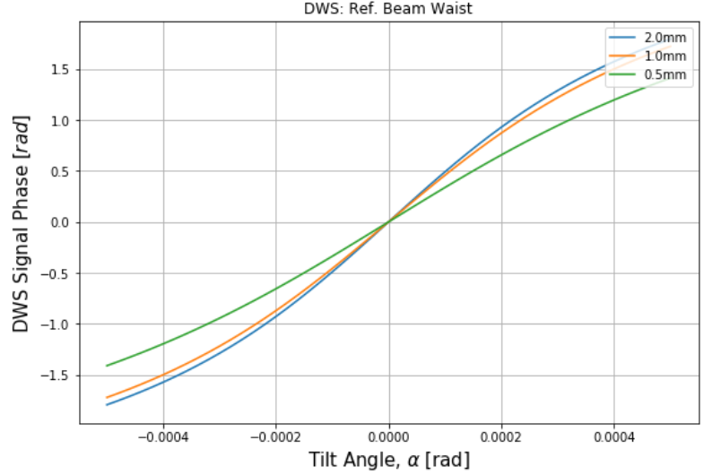
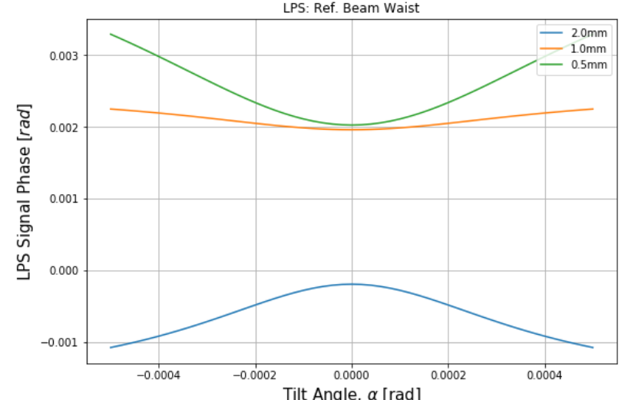
Ref. Beam Waist
Param. | Default Value [mm]
PD-ref. , meas. beam distance | 10
PD size | 2x2
PD gap | 0.02 (20micron right & left)
Meas. Beam waist | 0.23067
Ref. Beam waist | 1
Shift | 0
Tilt | [-500,500] microrad

Slide 11
Shift = 10 um
Default values
Changing one parameter/slide

Slide 12
Defaults
Param. | Default Value [mm]
PD-ref. , meas. beam distance | 10
PD size | 2x2
PD gap | 0.02 (20micron right & left)
Meas. Beam waist | 0.23067
Ref. Beam waist | 1
Shift | 10 micron
Tilt | [-500,500] microrad

Slide 13
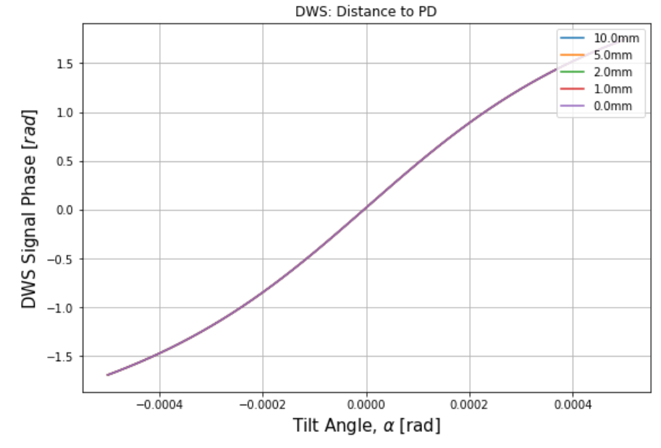
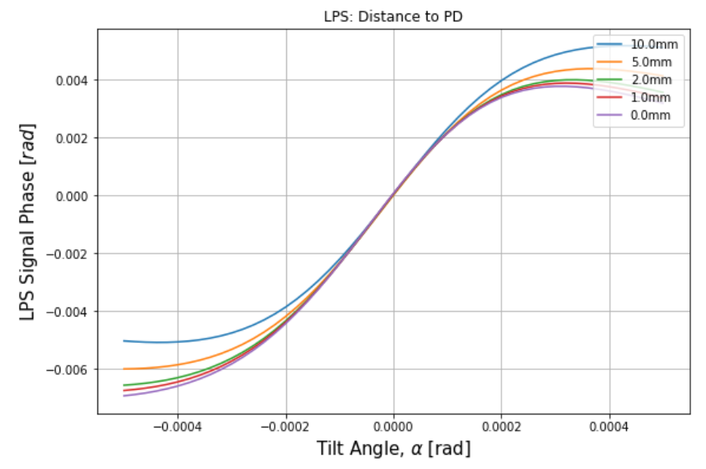
Distance to PD[mm]
Param. | Default Value [mm]
PD-ref. , meas. beam distance | 10
PD size | 2x2
PD gap | 0.02 (20micron right & left)
Meas. Beam waist | 0.23067
Ref. Beam waist | 1
Shift | 10 micron
Tilt | [-500,500] microrad

Slide 14
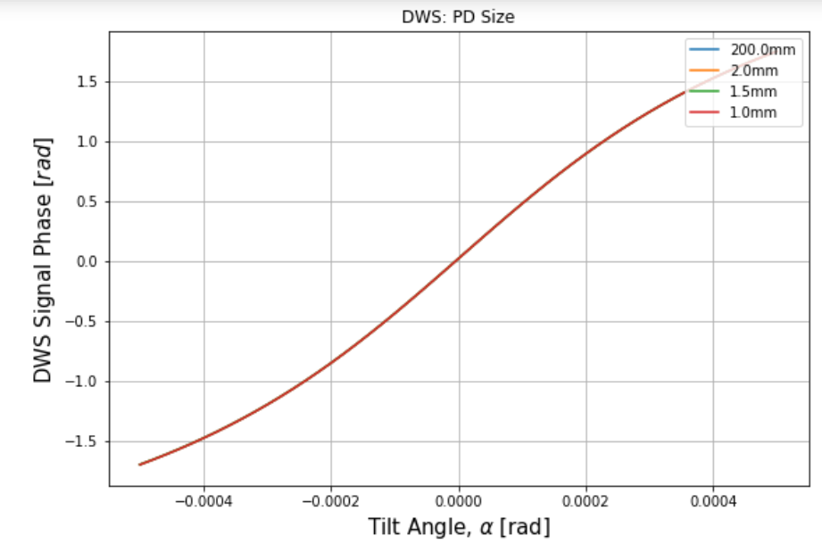
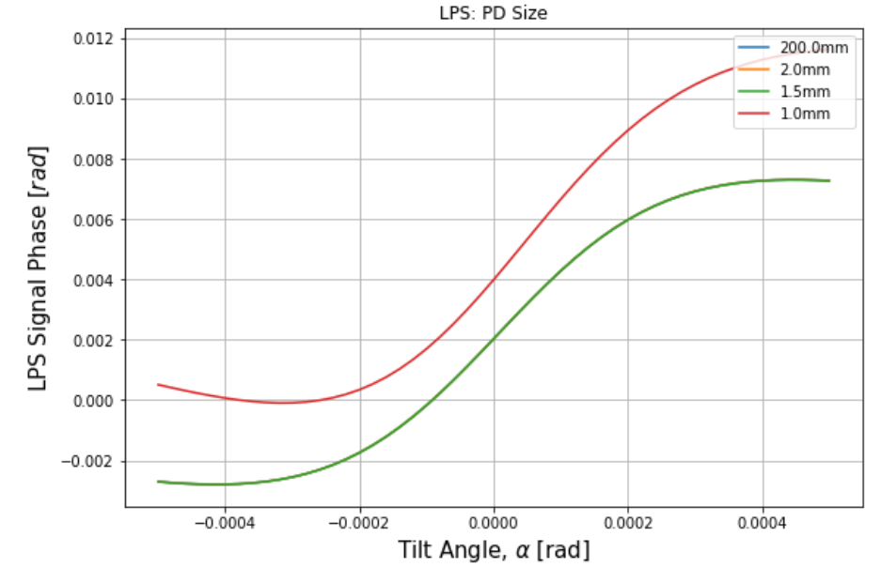
PD size [mm]
Param. | Default Value [mm]
PD-ref. , meas. beam distance | 10
PD size | 2x2
PD gap | 0.02 (20micron right & left)
Meas. Beam waist | 0.23067
Ref. Beam waist | 1
Shift | 10 micron
Tilt | [-500,500] microrad

Slide 15
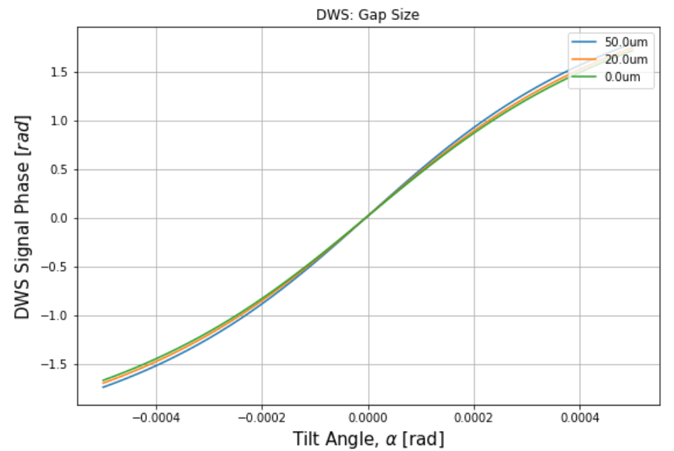
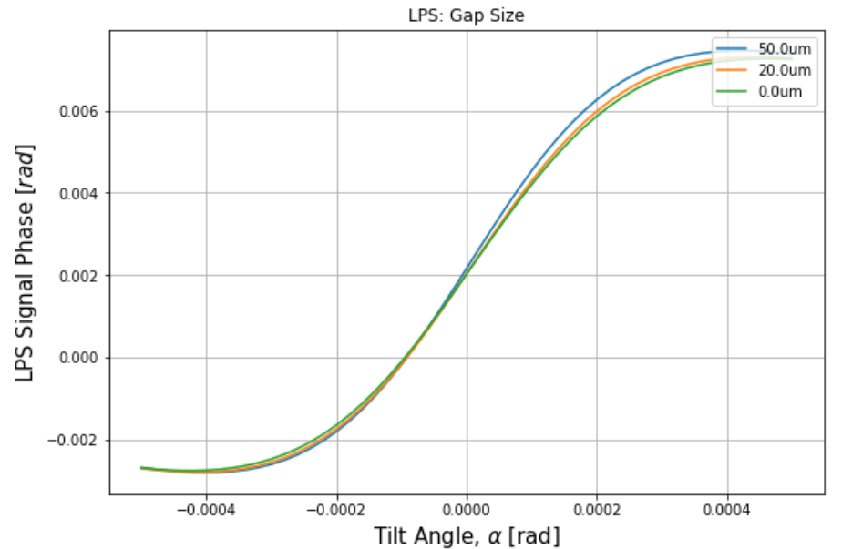
Gap Size [mm] (half-gap)
Param. | Default Value [mm]
PD-ref. , meas. beam distance | 10
PD size | 2x2
PD gap | 0.02 (20micron right & left)
Meas. Beam waist | 0.23067
Ref. Beam waist | 1
Shift | 10 micron
Tilt | [-500,500] microrad

Slide 16
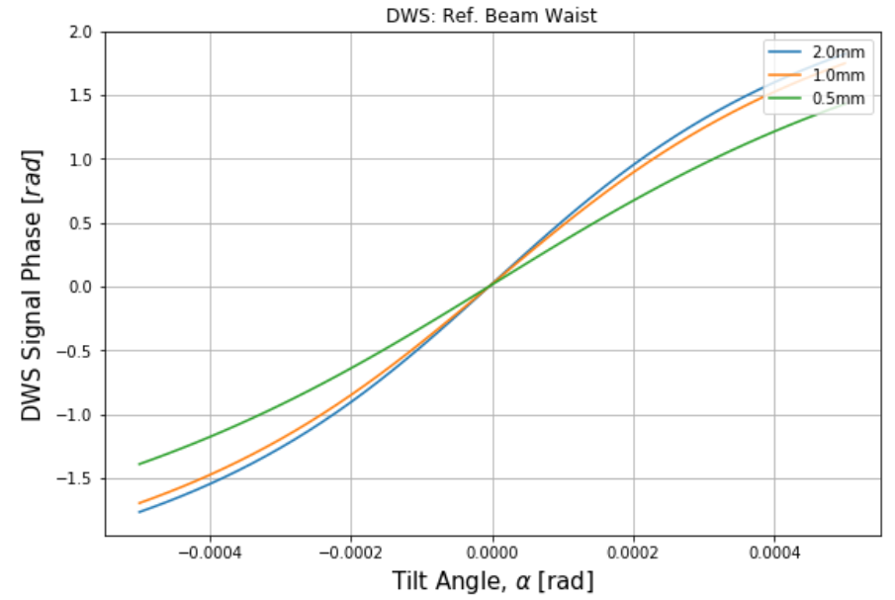
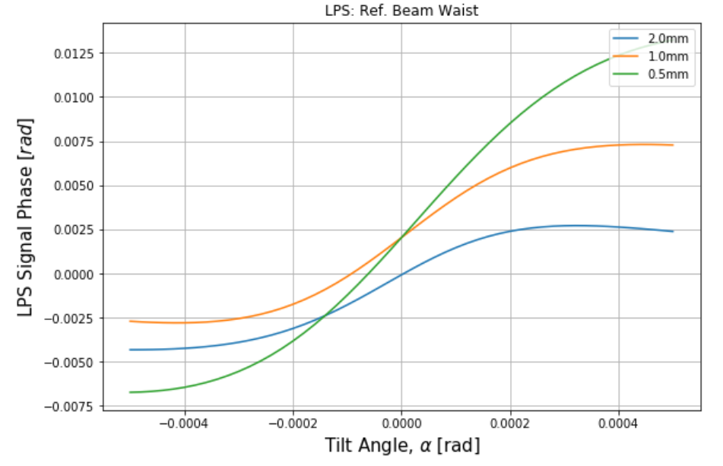
Ref. Beam Waist
Param. | Default Value [mm]
PD-ref. , meas. beam distance | 10
PD size | 2x2
PD gap | 0.02 (20micron right & left)
Meas. Beam waist | 0.23067
Ref. Beam waist | 1
Shift | 10 micron
Tilt | [-500,500] microrad

Slide 17
Shift = 100 um
Default values
Changing one parameter/slide

Slide 18
Defaults
Param. | Default Value [mm]
PD-ref. , meas. beam distance | 10
PD size | 2x2
PD gap | 0.02 (20 micron right & left)
Meas. Beam waist | 0.23067
Ref. Beam waist | 1
Shift | 100 micron
Tilt | [-500,500] microrad

Slide 19
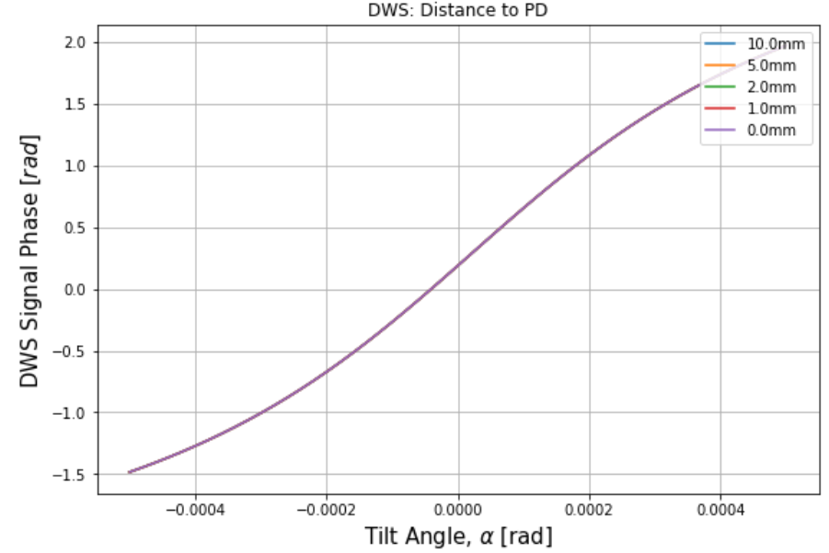
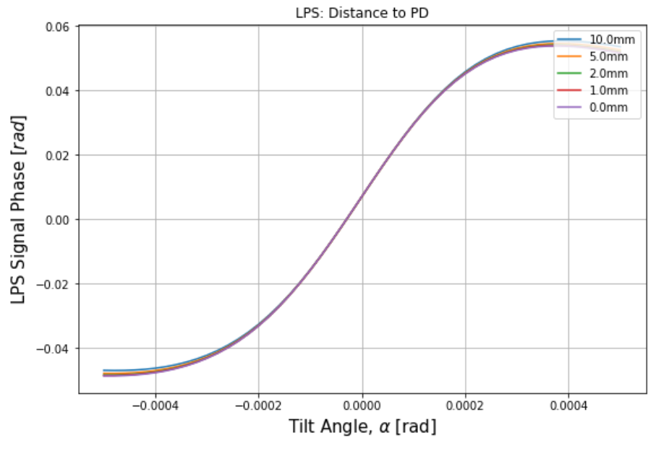
Distance to PD[mm]
Param. | Default Value [mm]
PD-ref. , meas. beam distance | 10
PD size | 2x2
PD gap | 0.02 (20micron right & left)
Meas. Beam waist | 0.23067
Ref. Beam waist | 1
Shift | 100 micron
Tilt | [-500,500] microrad

Slide 20
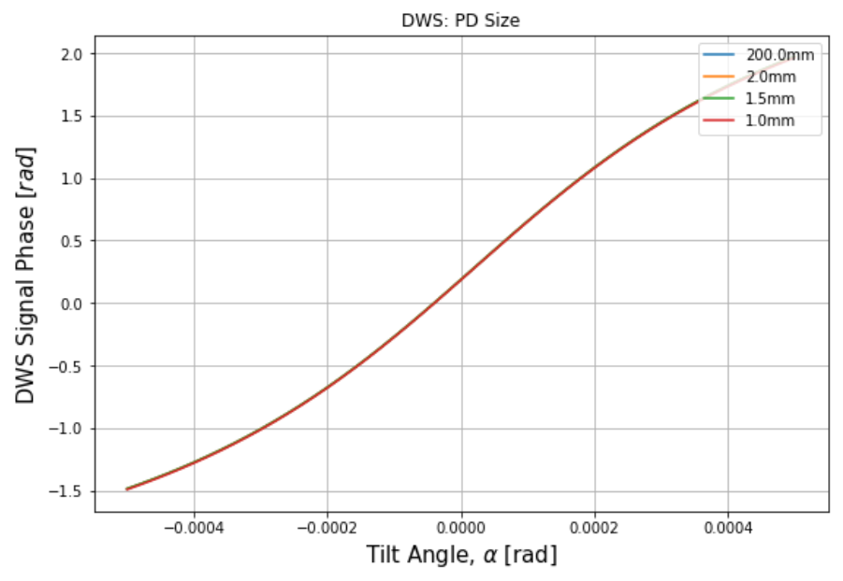
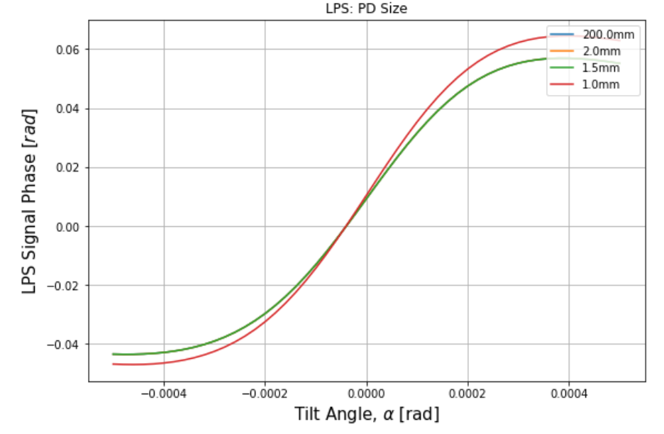
PD size [mm]
Param. | Default Value [mm]
PD-ref. , meas. beam distance | 10
PD size | 2x2
PD gap | 0.02 (20micron right & left)
Meas. Beam waist | 0.23067
Ref. Beam waist | 1
Shift | 100 micron
Tilt | [-500,500] microrad

Slide 21
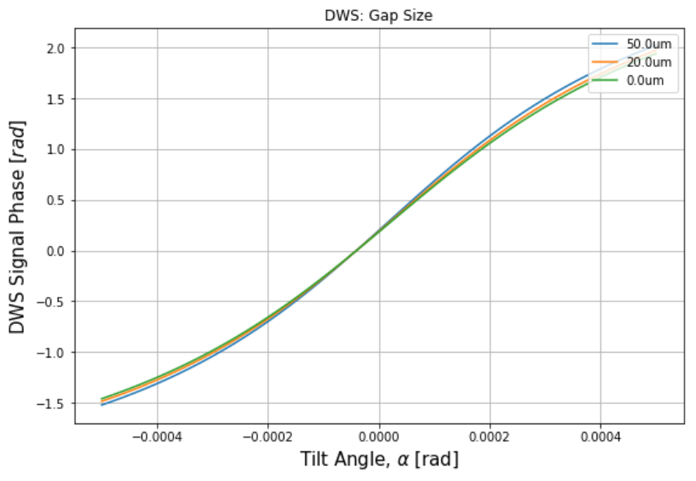
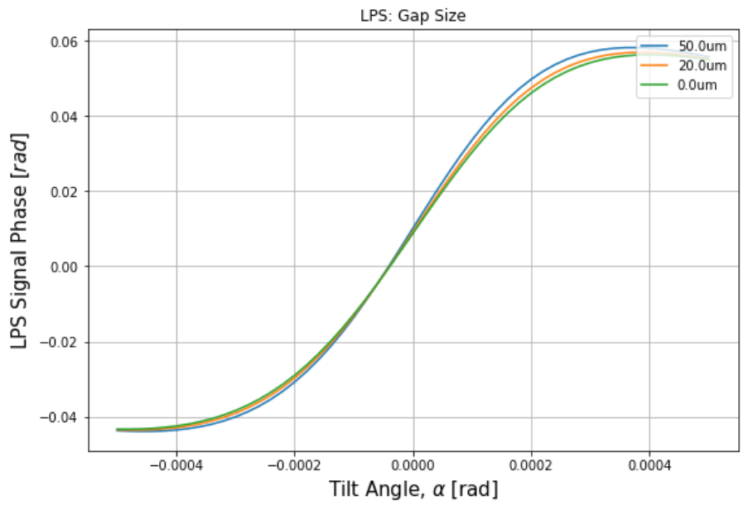
Gap Size [mm] (half-gap)
Param. | Default Value [mm]
PD-ref. , meas. beam distance | 10
PD size | 2x2
PD gap | 0.02 (20micron right & left)
Meas. Beam waist | 0.23067
Ref. Beam waist | 1
Shift | 10 micron
Tilt | [-500,500] microrad

Slide 22
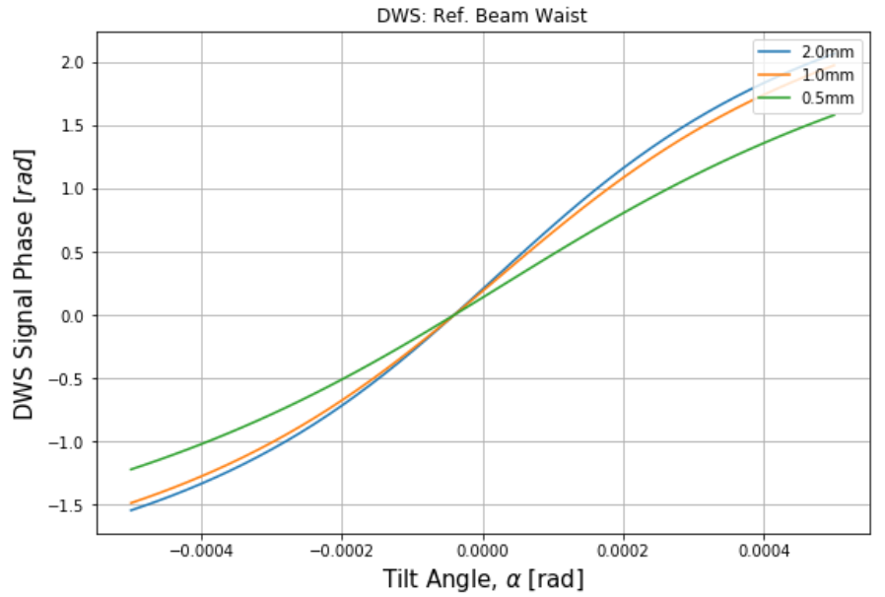
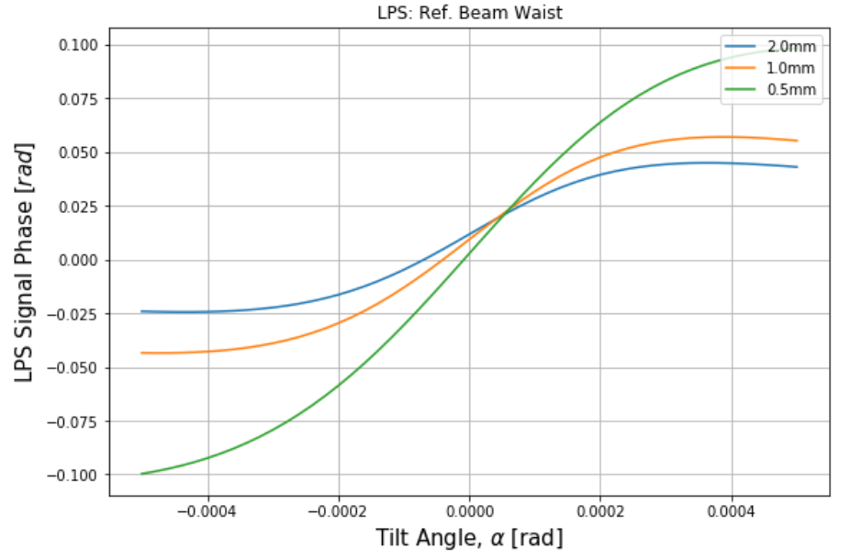
Ref. Beam Waist
Param. | Default Value [mm]
PD-ref. , meas. beam distance | 10
PD size | 2x2
PD gap | 0.02 (20micron right & left)
Meas. Beam waist | 0.23067
Ref. Beam waist | 1
Shift | 100 micron
Tilt | [-500,500] microrad

